Slide 1

Final Presentation
Product Space x Toast
Fall 2025

Slide 2








Meet the Team
Project Manager
Senior
Product Analyst
Janice
Econ | ‘27
Viraj
OPAN | ‘26
Raymond
Human
Science | ‘28
Jessica
STIA | ‘28
Lucas
Finance &
OPAN | ‘27
Ella
Marketing & OPAN | ‘28

Slide 3

Table of Contents
Project Scope
Competitive Features Analysis
Survey Data Analysis
AI Optimization
Feature Proposal
Conclusion

Slide 4


Project Scope
Deliverables and Methodology

Slide 5
Project Scope
01
02
03
04
Competitive Features Matrix
Consumer Preferences Survey
Top-of-Funnel AI Audit
Feature Proposal & Build Out
Internal Product Space at Georgetown Use Only*

Slide 6
Methodology
Features Matrix
Survey
AI Audit
Feature Proposal
Goal: Identify valuable features for Toast
Analysis of 11 competitors
Creation of comprehensive features matrix
Further research centralized into features matrix
Goal: Understand consumer habits and preferences when ordering food online
50 respondents
Used a $25 gift card lottery drawing incentive
Goal: Understand how Toast can adapt to new technologies for consumers
Explored AI logic for recommending restaurants
Audited Chat GPT, Gemini, Perplexity, and Claude
Goal: Propose new feature for Toast to implement
Fleshed out feature identified from the matrix phase
Created a Product Requirements Doc and Figma mockup

Slide 7
Competitive Feature Analysis
01

Slide 8


Competitor Audit Example: Incentivio
Feature: AI-Driven User Dashboard & Loyalty Personalization
Strengths
Weaknesses
Centralized dashboard with guest order history, preferences, engagement metrics
Predictive analytics to identify high-value customers
Enables personalized loyalty campaigns and dynamic offers
Reports of data sync delays
Requires technical setup
Full value depends on tight POS + ordering integration
Opportunities
Threats
Expand predictive loyalty insights and segmentation models
Add easier-to-read dashboards for franchise + multi-location operators
Adoption risk if restaurants can’t operationalize AI insights effectively

Slide 9
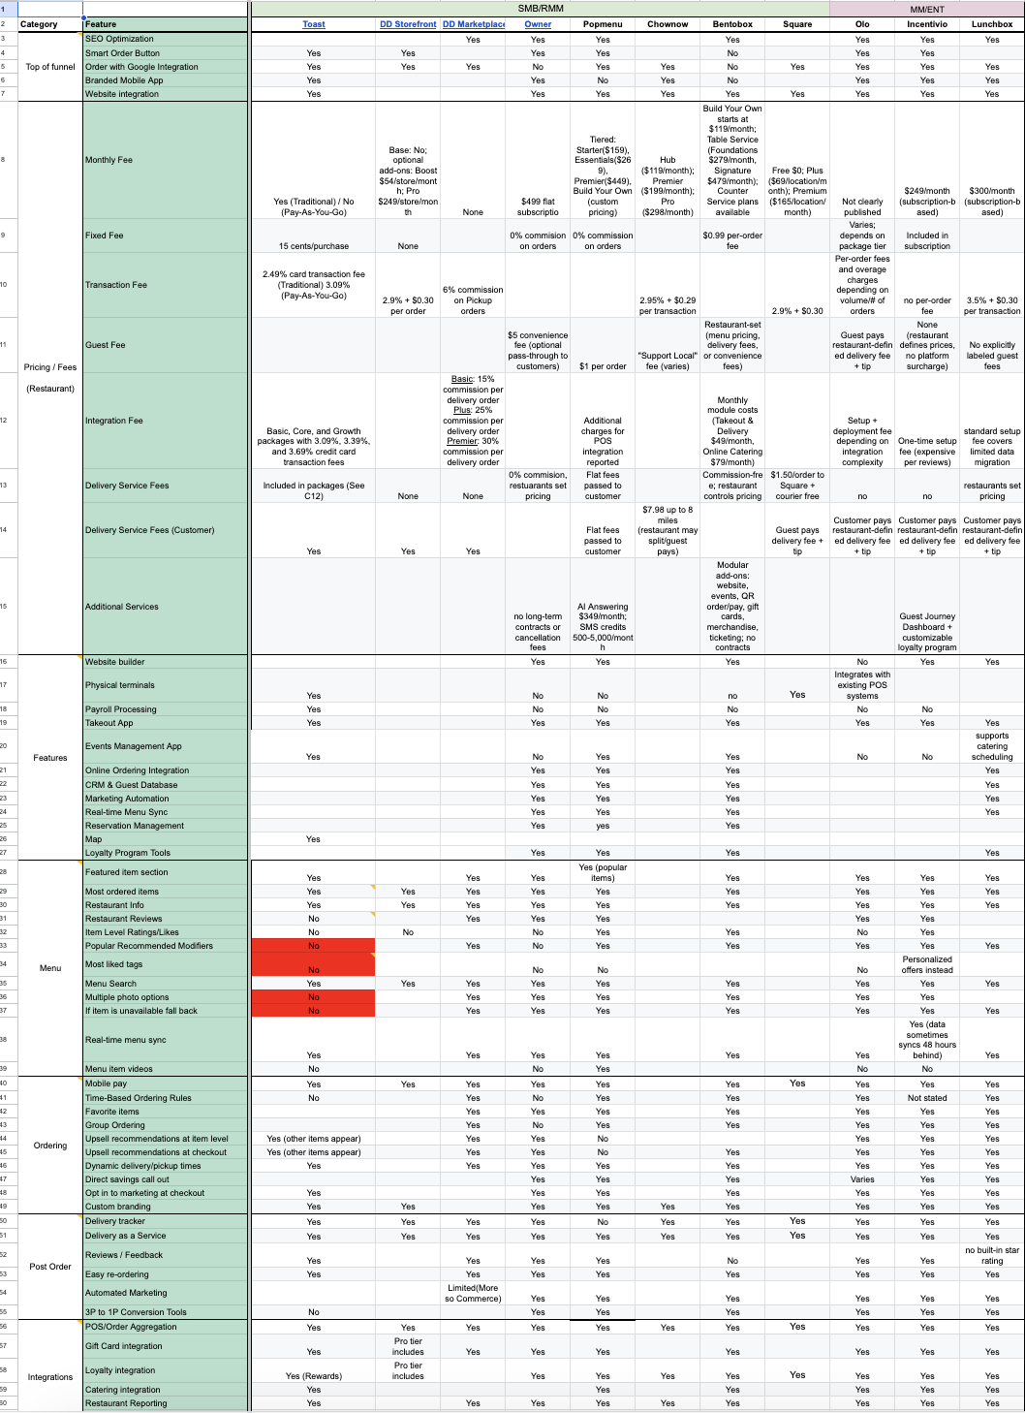
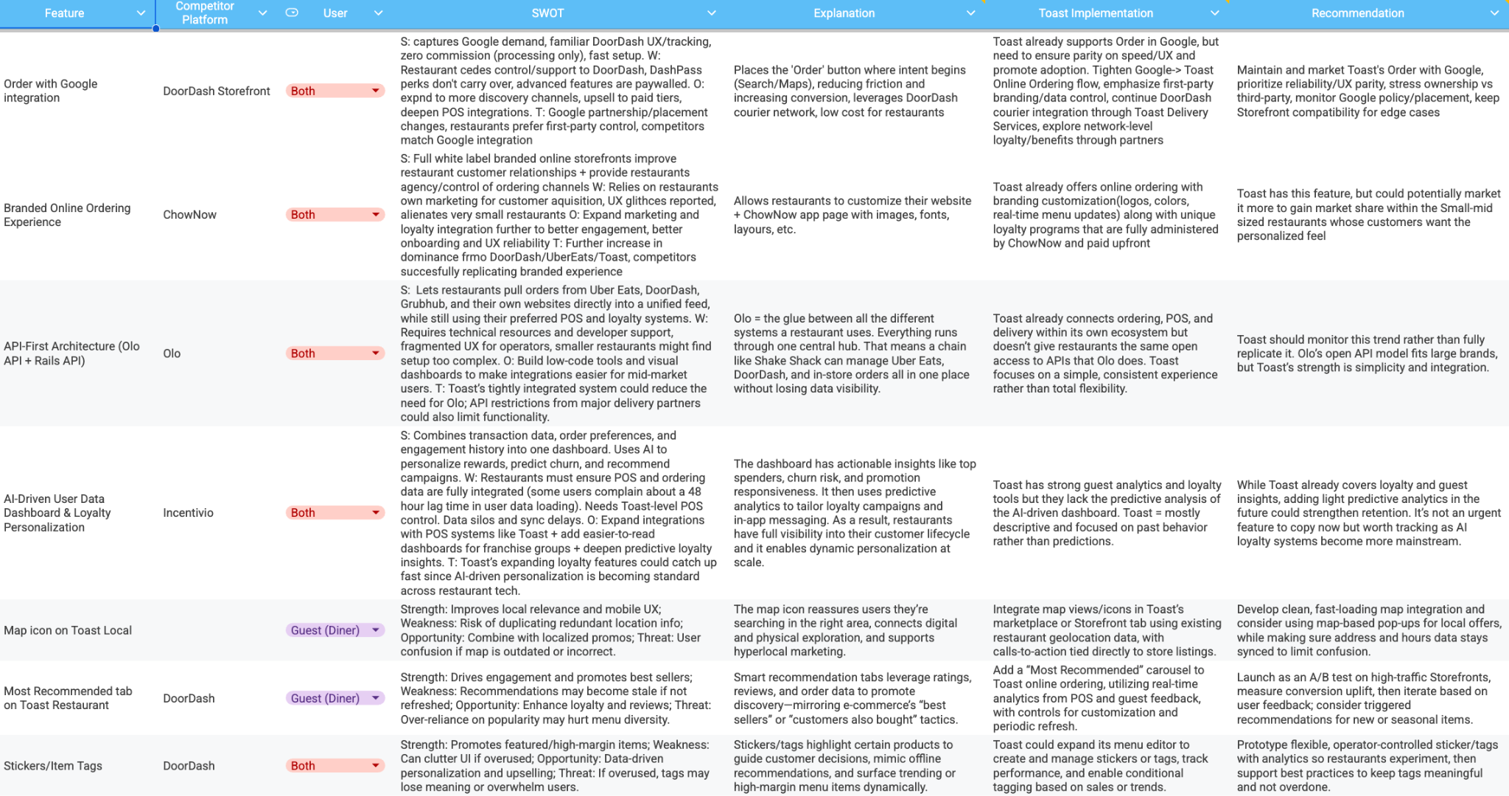
Competitive Features Matrix
Feature Analysis Matrix

Slide 10
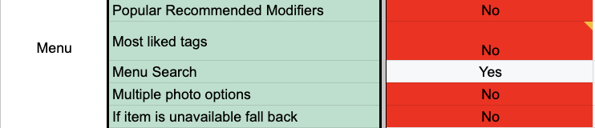

Slide 11
Survey Data Analysis
02
Student ordering behaviors and implications for Toast

Slide 12
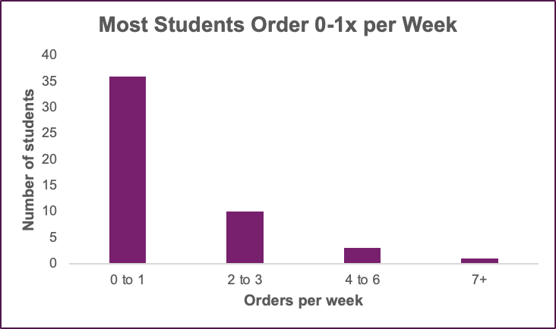
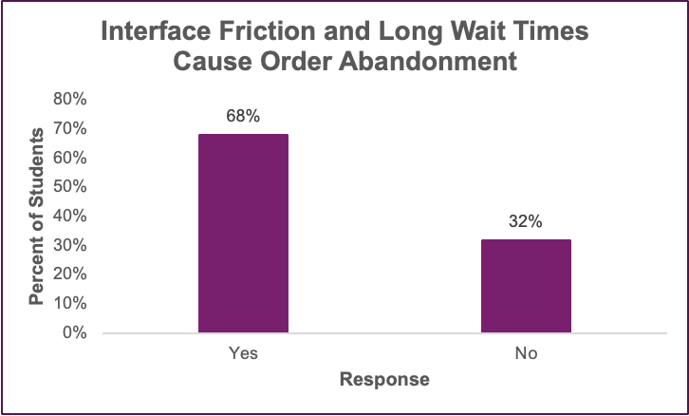
High-Level Insights: Student Ordering Behavior
Behavior
Key takeaway:
Students are low-frequency users, so each order moment is a fresh win-or-lose decision
Implication for Toast:
Reduce friction/decrease wait times in menu navigation, customization, and checkout in direct-ordering flow to
capture occasional users

Slide 13
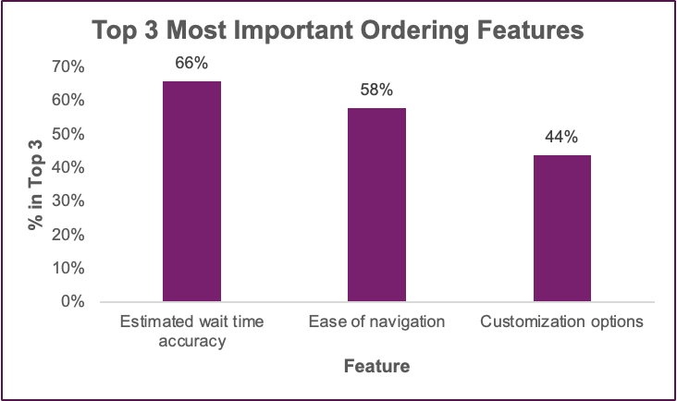
High-Level Insights: Student Ordering Behavior
Decision Drivers
Key takeaway:
A “good” experience means accurate wait times, fast navigation, and easy customization
Implication for Toast:
Implement new features to streamline customer experience

Slide 14
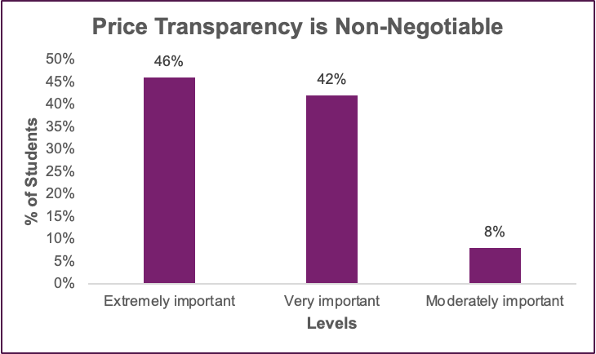
High-Level Insights: Student Ordering Behavior
Pricing Friction
Key takeaway:
Students want to see the full cost clearly
Implication for Toast:
Show fees and total upfront to reduce cart abandonment

Slide 15
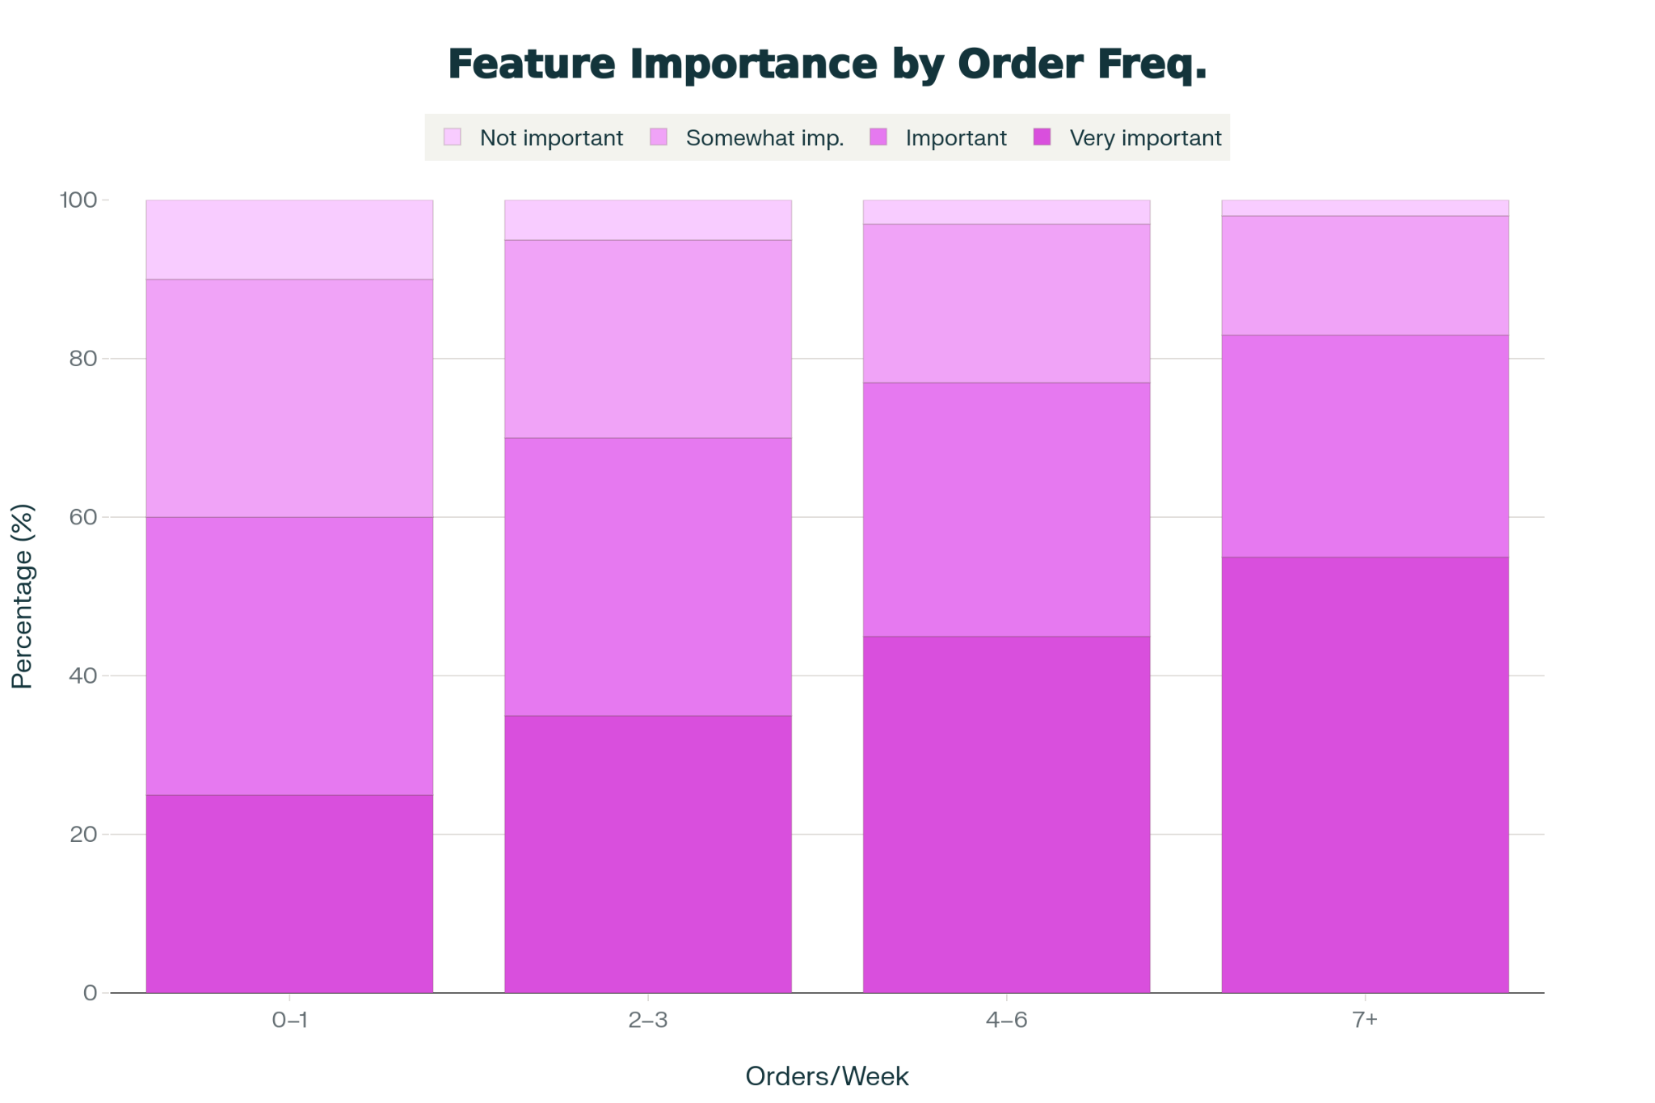
Feature Importance increase with Frequency
As orders per week rise, the “Very important” segment grows and “Not important” shrinks.
As students order more often, they become much more demanding about post‑order reliability—accurate ETAs, real‑time updates, and clear receipts.
Toast can differentiate by positioning itself as the “trustworthy operations layer” by handling post‑order operations

Slide 16
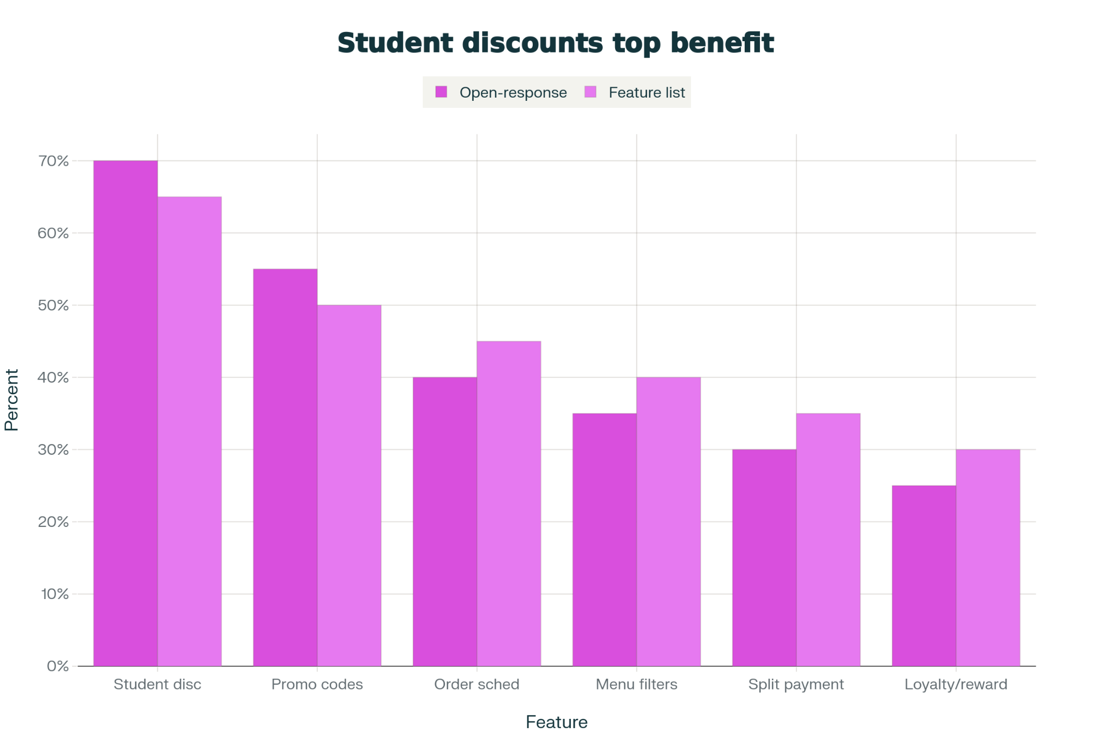
Student-only discounts as the strongest lever
Students mention student-discounts the most across the survey when discussing their ordering preferences.
Other features like menu filters and split payments are less important than pricing.
Use “same-as-in-store pricing + exclusive student deals” as a key message when selling Toast

Slide 17
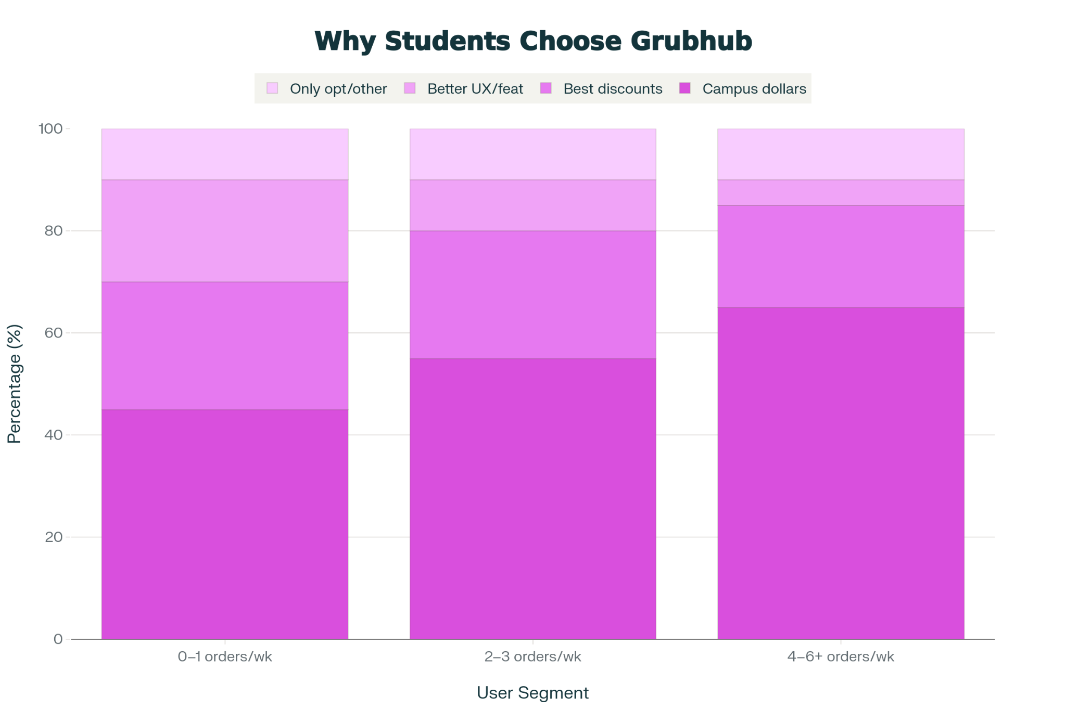
Implement Partnerships with Universities
Across light, medium, and heavy Grubhub users, the majority say they use it because of campus dollars/stipends
Only a small slice attribute their choice to better UX/features–GrubHub wins on campus dollars
Imitate GrubHub by giving restaurants tools to accept campus dollars/Flex‑style balances.

Slide 18
AI Optimization
03
Platform Response Optimization and Ranking

Slide 19
AI Platform Restaurant Ranking Logic
Gemini
ChatGPT
Perplexity
Trust/Authority via E-E-A-T score (reviews, citations)
Deep integration with Google Business Profile
Review volume, sentiment, and recency are crucial
FAQ sections important
Prioritizes complete Google business profiles
Restaurant Name, Address, Category, Hours, Website, photos, menus etc
Fast load times
Mobile-website accessibility
Online Reviews + restaurant responses
Has a booking partnership with Opentable that lets users discover + reserve tables at 60,000 restaurants through perplexity
Google Review rating, frequency, velocity
Cross platform citations creates “Snowball effect”
Notes:
https://www.perplexity.ai/hub/blog/book-a-table-with-perplexity-and-opentable?
https://support.google.com/business/answer/7091?hl=en#zippy=%2Crelevance%2Cdistance%2Cprominence
https://support.google.com/business/answer/2721884?sjid=1959068079924437523-NA
https://get.chownow.com/blog/local-seo-for-restaurants/ https://www.gourmetmarketing.net/blog/major-myths-google-algorithm-restaurants

Slide 20
AI Optimization Strategies
Embed online reviews into websites
Include FAQ sections for Restaurant sites
Incentivize reviews through POS systems
01
02
03
Toast already excels at managing restaurant Google Business Profile data and ensuring cross-platform consistency. So, by embedding online reviews into restaurant sites and including AI generated FAQ sections they could move ahead of the competition in terms of SEO optimization

Slide 21
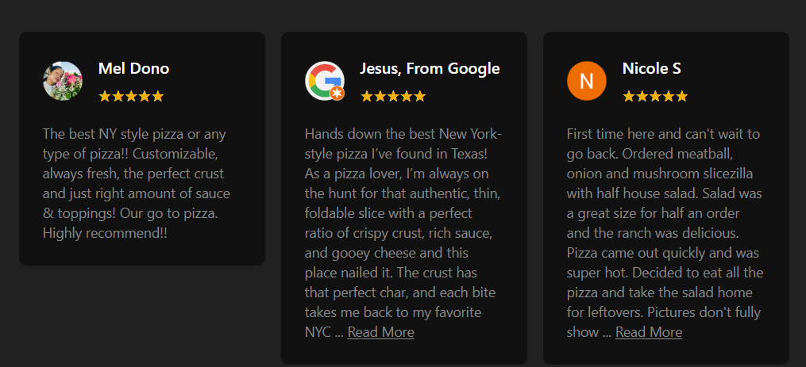
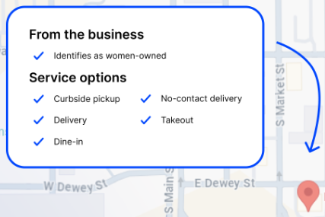
AI Optimization Strategies(continued)
Simple FAQ sections on restaurant websites ensure that sites like Google autofill important information like takeout availability
Embedded review sections on websites increase credibility through cross-platform verification

Slide 22
Feature Proposal
04
Restaurant Menu Filtering

Slide 23
Paint Point: Lack of Personalization & Clarity
Current menus make it difficult to quickly identify:
Allergen-safe items (e.g., nuts, dairy, gluten)
Dietary preferences (vegan, vegetarian, halal)
Spice levels or flavor profiles
Can lead to confusing UX, menu overwhelm, and turn away customers
Survey results showed interface friction causes order abandonment for 68% of respondents
Ease of navigation is a highly valued feature when customers use online ordering systems, ranking first in feature value ~32% of the time.
Notes:
when asked to rank various feature in order of importance, ease of navigation got the most first place ranks (16/49) 3 second places, 10 third places and 10 fourth place rankings

Slide 24
Menu Filtering: Goals & Strategic Fit
Improve Menu Navigation
Transparency and Trust
Help diners quickly find items that meet their dietary needs
Tag menu items with key terms (e.g., spicy, vegan, vegetarian, gluten-free, contains nuts)
Reduce menu overwhelm for long/complex menus
Builds transparency → increases customer trust
Operational Efficiency
Ease of Integration
Assists customer ordering flow efficiency
Servers find items faster in POS search
Minimal overhaul or engineering
Enhances customer experience by simplifying ordering operations
Notes:
Tthis connects to survey results bc ease of order mattered a lot for our survey respondents

Slide 25

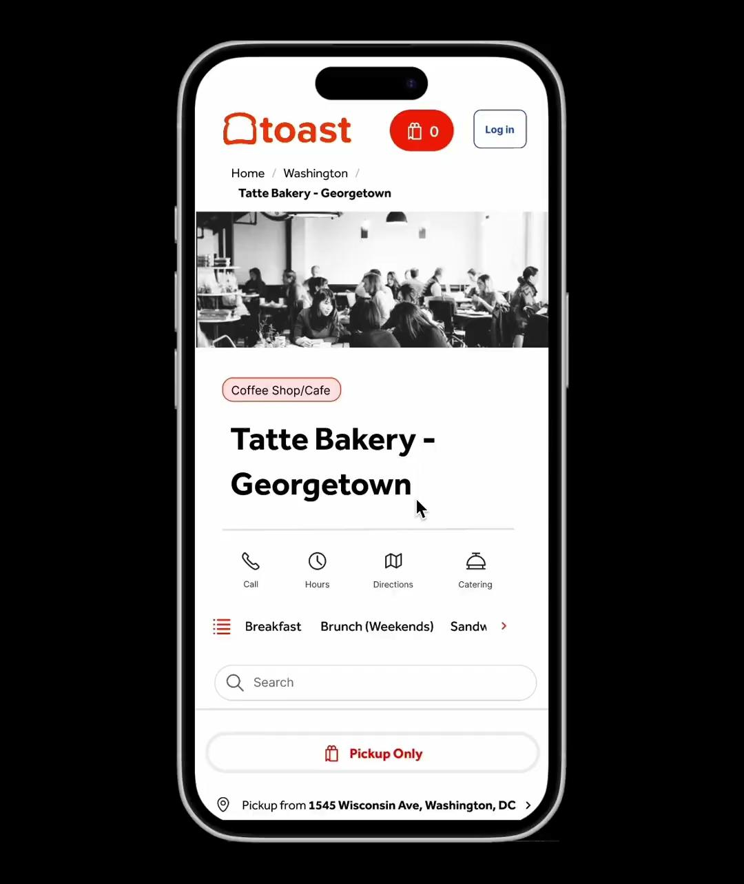
Current State
Mockup

Slide 26
Conclusion
05
Key takeaways and next steps

Slide 27
Takeaways
Key Takeaways and Recommendations
01
Prioritize financial accessibility when targeting students for online ordering through campus partnerships and student-specific discounts
02
Embed online reviews into Toast’s restaurant sites and include AI generated FAQ sections to optimize AI search results
03
Implement a filtering feature for Toast online ordering site menus to improve customer experience and ease of usage

Slide 28
Thank you!
Contact:
productspacegeorgetown@gmail.com
Instagram: @productspacegeorgetown

Slide 29
Short Title
SECTION THREE
Text text text.
See picture on the side!

Slide 30
Title
Section
Text
Key Takeaway

Slide 31

Section
Title
Text

Slide 32
Short Title
Text text text
Text text text
Text text text
Text text text

Slide 33
Short Title
Text text text
Text text text
Text text text

Slide 34
Title

Slide 35
Short Title
Text text text
Text text text
Text text text

Slide 36

Thank You!
Contact:
productspacegeorgetown@gmail.com
Instagram: @productspacegeorgetown

Slide 37
Table of Contents
Project Scope
Competitive Features Analysis
Survey Data Analysis
Feature Proposal
AI Optimization
Conclusion

Slide 38
Table of Contents

